Slide 1

Welcome to Our Presentation

Slide 2
Agenda

Slide 3
01
02
03
Business Case Study
Agenda
Solution Implementation Steps
Questions & Answers

Slide 4

“This project seeks to enhance global business operations by establishing a secure and reliable network connection between critical Azure Resource and VMs.
By implementing a Point-to-Site VPN, we will enable seamless data transfer, application integration, and collaboration across international boundaries.
This secure connection will facilitate remote access to resources, streamline business processes, and support global expansion initiatives.
The project will prioritize low latency, high performance, and robust security measures to ensure uninterrupted business continuity and compliance with data privacy regulations.

Slide 5
After more investigation with Customer’s needs, we concluded the following requirements:
01
02
Low Latency: and High Performance: The customer expects minimal latency and high data transfer speeds to ensure efficient and responsive communication between the services and VMs on Azure, regardless of their geography.
Robust Security: The customer demands a secure network connection that protects sensitive data from unauthorized access, interception, or tampering. This includes strong encryption, authentication mechanisms, and regular security audits.
04
03
Reliability and Uptime: The customer needs a VPN connection with high availability and minimal downtime to ensure uninterrupted business operations. This includes redundancy measures and proactive monitoring to address potential issues promptly.
Scalability: The customer anticipates future growth in data traffic and requires a VPN solution that can easily accommodate increased demand without compromising performance.

Slide 6

Let’s take it step by step

Slide 7
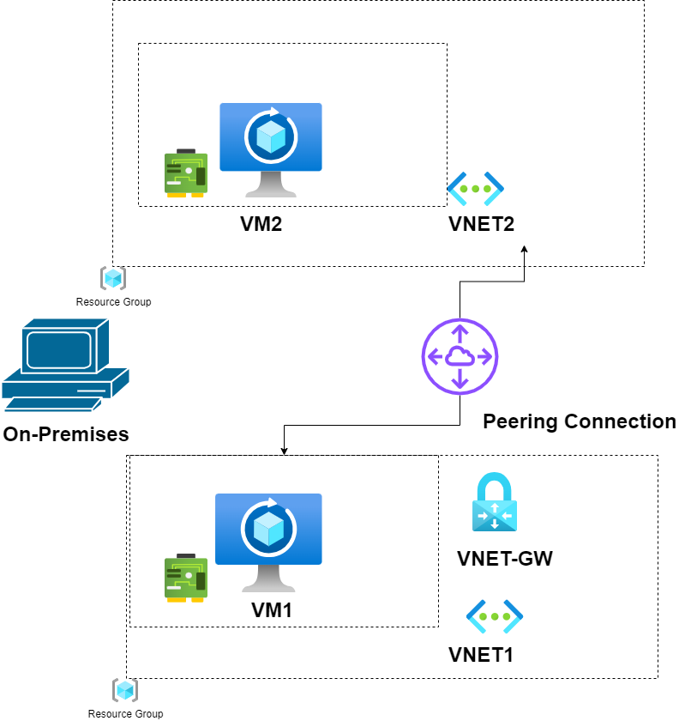
Our Solution:
Created a comprehensive Point-to-Site VPN solution.
The elements from both diagrams Included:
Virtual Machines: VM1 and VM2
Virtual Networks: Vnet1 and Vnet2
Network Interfaces: vm1859_z3 and vm2721_z1
Network Security Groups: VM1-nsg and VM2-nsg
VPN Gateways: VNet-GW (in Vnet1) and VNet2-GW (in Vnet2).
01
REQUIREMENT 1: Low Latency
The customer expects minimal latency and high data transfer speeds to ensure efficient and responsive communication between the services and VMs on Azure, regardless of their geographic locations.

Slide 8
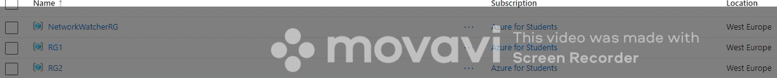
d
Our Solution:
Created a two Resource Groups(RG1 + RG2) With Two Virtual Network (VNET1 + VNET2)
(Each Virtual Network Assign to Resource Group From Below VNET1 For Resource Group RG1)
01
REQUIREMENT 1: Network Segmentation
The customer requires a cloud design with centralized management and two workload environments: Production and Testing.

Slide 9
Our Solution:
Chose Creating Virtual Machines (VM1 + VM2) for greater control and customization.
Deployed Each VM For Each Resource Group in each spoke VNet to host the web application components, ensuring redundancy and high availability.
02
REQUIREMENT 2: Workload Hosting Service
The customer needs a suitable workload hosting service for his web application with greater control and customization.

Slide 10
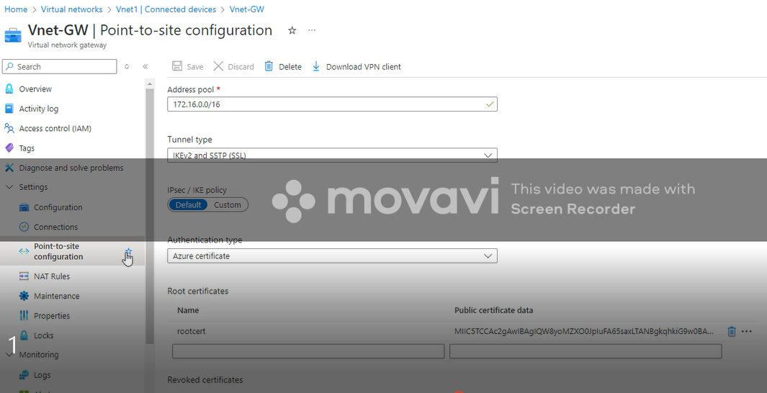
Our Solution:
Configured the Virtual Network Gateway (Point -to- Site) to establish a secure connection between the on-premises network and Azure..
Implemented The Address Pool and Authentication Type and Other Parameters Then Apply Root Certifications .
03
REQUIREMENT 3: Application Delivery
The customer requires a regional, scalable load balancing option with applicable security rules to ensure secure and reliable delivery of his web application to end users.

Slide 11
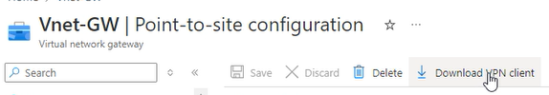

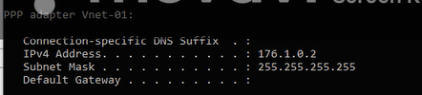
Our Solution:
Downloading and Installing VPN Client for protecting our online privacy, security, and allowing you to access content from around the world .
After Downloading We Will Install This Using Windows Amd64
After Connecting To (Vnet – 01) The VPN client will automatically assign an IP address from the configured address pool
04
REQUIREMENT 4: Secure Connectivity
The customer needs secure and efficient connectivity between the VNets ensuring low latency and high bandwidth communication between the web application components in the spokes and the centralized services in the hub.

Slide 12
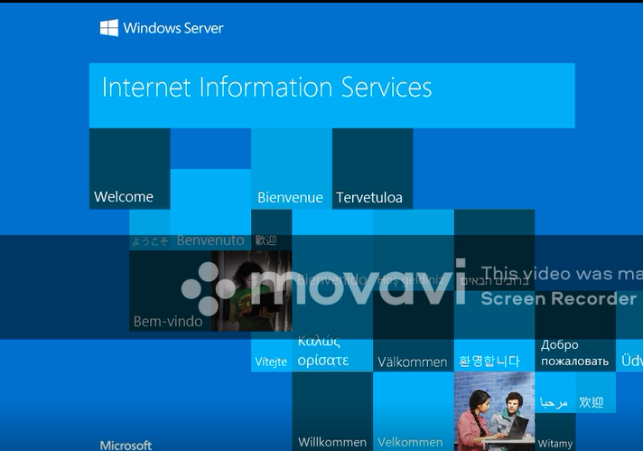
Our Solution:
Installing an Azure Resource (IIS Internet Information Services) On VM1 So We Can Access it Through The VPN Connection .
After Installing This Resource Successfully Now We Can Connect to This Resource Using Our PC
05
REQUIREMENT 5: Centralized Firewall
The customer wants a centralized network virtual appliance (NVA) solution to control and log all network traffic flowing between the VNets, providing an additional layer of security for our web application environment.

Slide 13
Our Solution:
Encryption Standards:
Specify the encryption algorithms and key lengths to be used (e.g., AES-256).
Example: Use AES-256 with a 256-bit key for encryption.
Authentication Methods:
Choose appropriate authentication methods (e.g., certificates, pre-shared keys) based on your security requirements.
Example: Use certificate-based authentication for enhanced security.
Access Control Policies:
Define granular access control policies to restrict access to specific resources or networks within the VPN tunnel.
Example: Create firewall rules to block unauthorized traffic.
Security Monitoring:
Implement continuous monitoring of the VPN connection for security threats and anomalies.
Example: Use intrusion detection systems to monitor for suspicious activity.
02
REQUIREMENT 2: Robust Security
Because The customer demands a secure network connection that protects sensitive data from unauthorized access, interception, or tampering. This includes strong encryption, authentication mechanisms, and regular security audits

Slide 14
Our Solution:
Traffic Growth Projections:
Estimate future traffic growth based on business trends and application usage.
Example: Project a 20% increase in traffic over the next year.
Scalability Mechanisms:
Identify mechanisms for scaling the VPN connection, such as adding VPN tunnels, increasing bandwidth, or using Azure Virtual WAN.
Example: Add additional VPN tunnels to increase capacity.
Performance Testing:
Conduct performance testing to ensure the VPN solution can handle projected traffic loads.
Example: Conduct stress tests to simulate peak traffic conditions.
03
REQUIREMENT 3: Scalability
The customer requires a regional, scalable load balancing option with applicable security rules to ensure secure and reliable delivery of his web application to end users.
.

Slide 15
Our Solution:
Service Level Agreement (SLA):
Define service level agreements with your VPN service provider, specifying uptime guarantees and performance metrics.
Example: Negotiate an SLA with a 99.99% uptime guarantee.
> Disaster Recovery Plan:
Develop a comprehensive disaster recovery plan to address potential outages and restore VPN connectivity quickly.
Example: Create a backup VPN connection and test the plan regularly.
Redundancy Strategies:
Implement redundancy mechanisms, such as multiple VPN tunnels or redundant VPN gateways, to minimize downtime.
Example: Use active-active redundancy for VPN gateways.
.
04
REQUIREMENT 4: Reliability and Uptime
The customer needs secure and efficient connectivity between the VNets ensuring low latency and high bandwidth communication between the web application components in the spokes and the centralized services in the hub

Slide 16
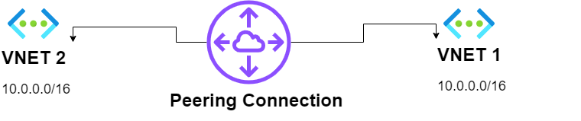
REQUIREMENT 5: Peerings Between 2 VNets
Our Solution:
This case study focuses on implemented Azure Peering to optimize its network. We will analyze the challenges they faced, the solutions they adopted, and the results achieved through this strategic move.
Post-implementation of Azure Peering, the company observed significant improvements in network performance and user experience. This slide will present key insights and statistics that demonstrate the effectiveness of their strategy.
Azure Peering offers substantial benefits for optimizing connectivity. Organizations should consider adopting this technology to enhance their cloud strategies. Future steps include continuous monitoring and adapting to evolving network demands

Slide 17
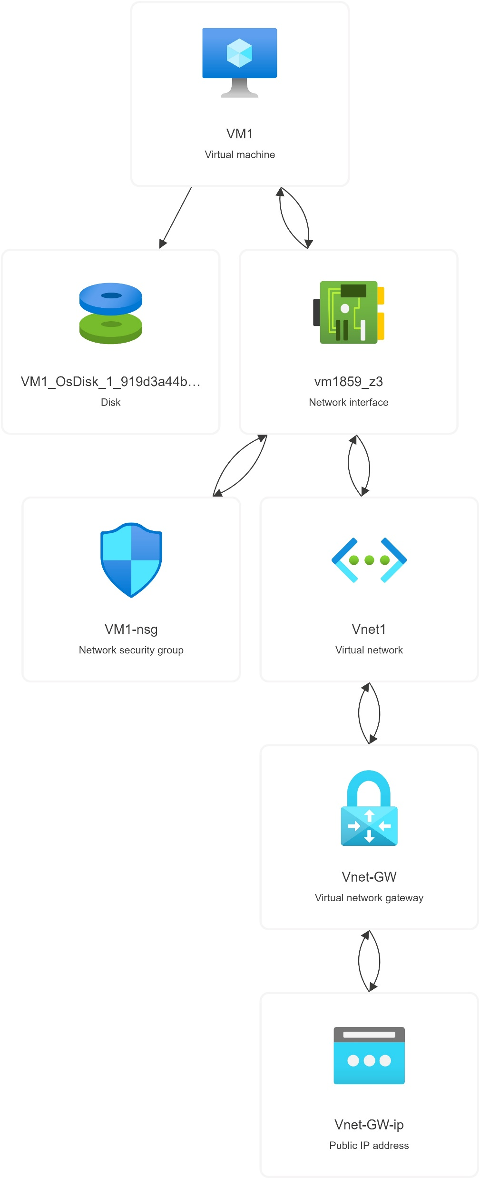
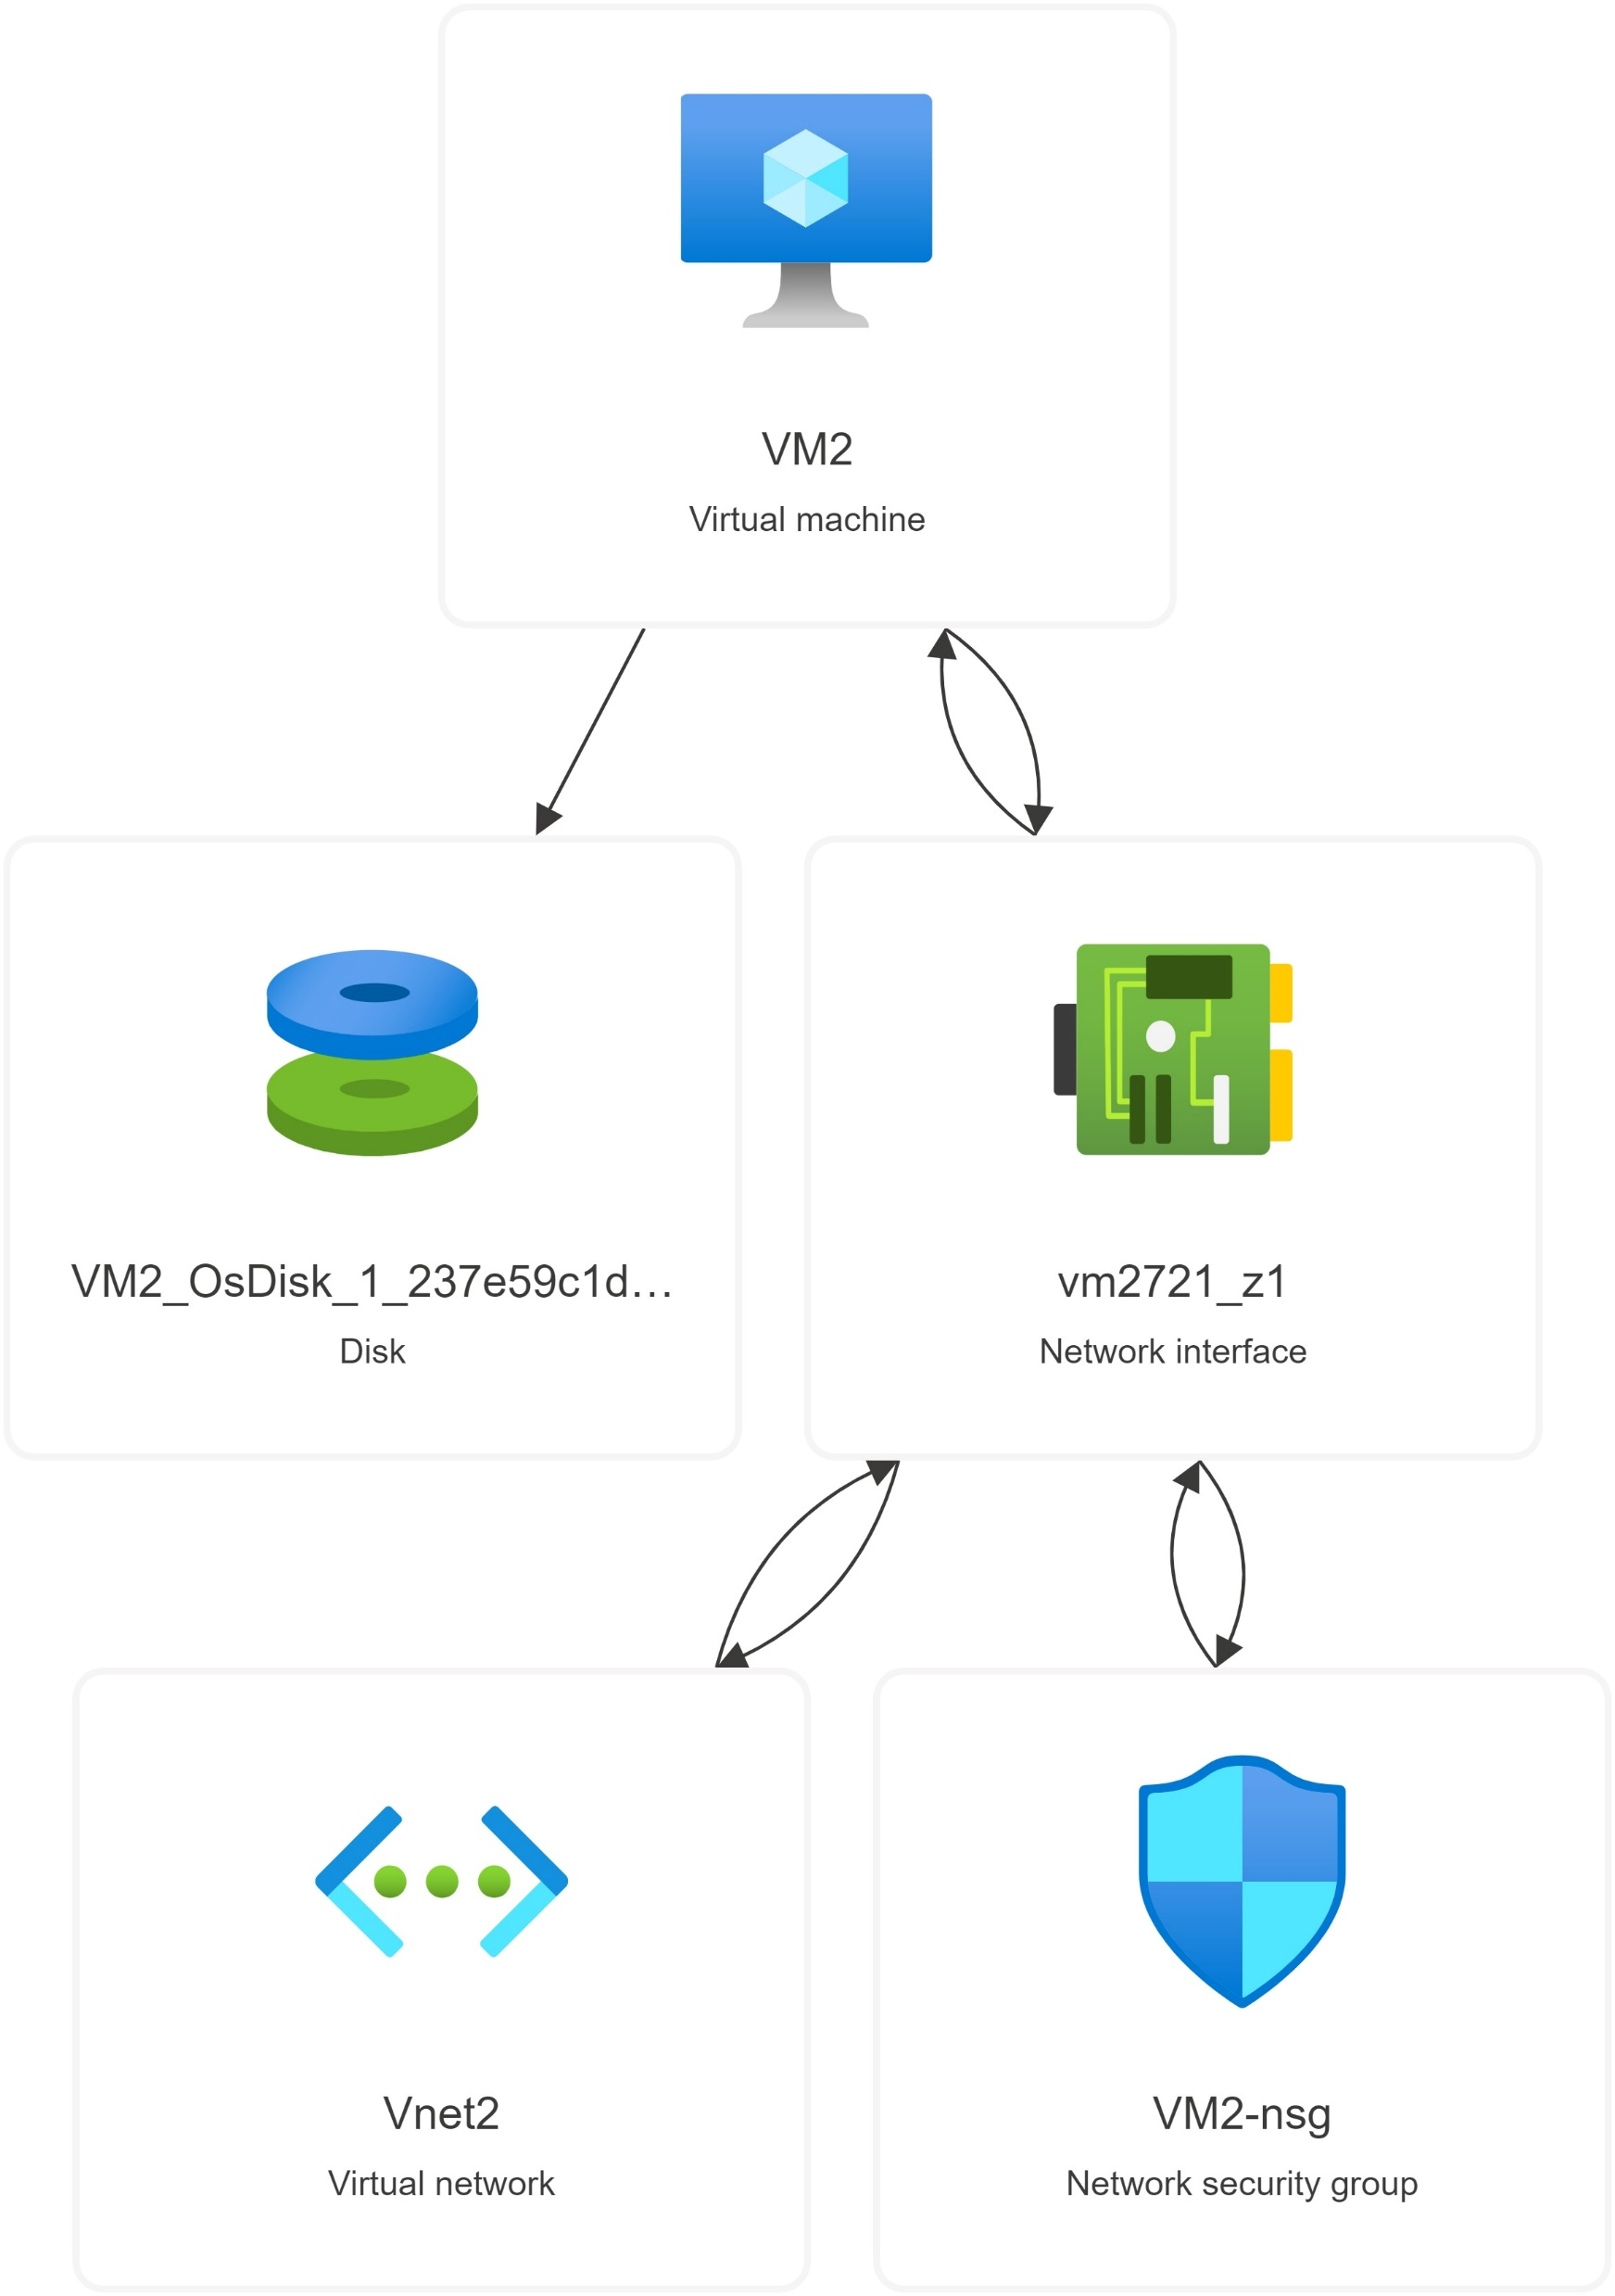
The Final Architecture

Slide 18
Team Members : -
Mahamoud Mostafa Mahmoud Mohamed
Mohamed Mahmoud Hasan Aly Waly
Rami Adel Hanafy
Ibrahim Mahmoud Mashaly

Slide 19

Any Questions

Slide 20

Thanks

